Slide 1


DATA COLLECTION SYSTEM
3rd March 2026
Daikai Engineering Pte Ltd
Version 7
Notes:
Good morning everyone, I am _______ from DSG’s IT department. today i will be presenting DRUMS the Daikai Remote Unified Monitoring System.
This platform represents Daikai’s vision of moving from traditional engine monitoring toward a centralized and intelligent monitoring ecosystem for vessels and power systems.

Slide 2
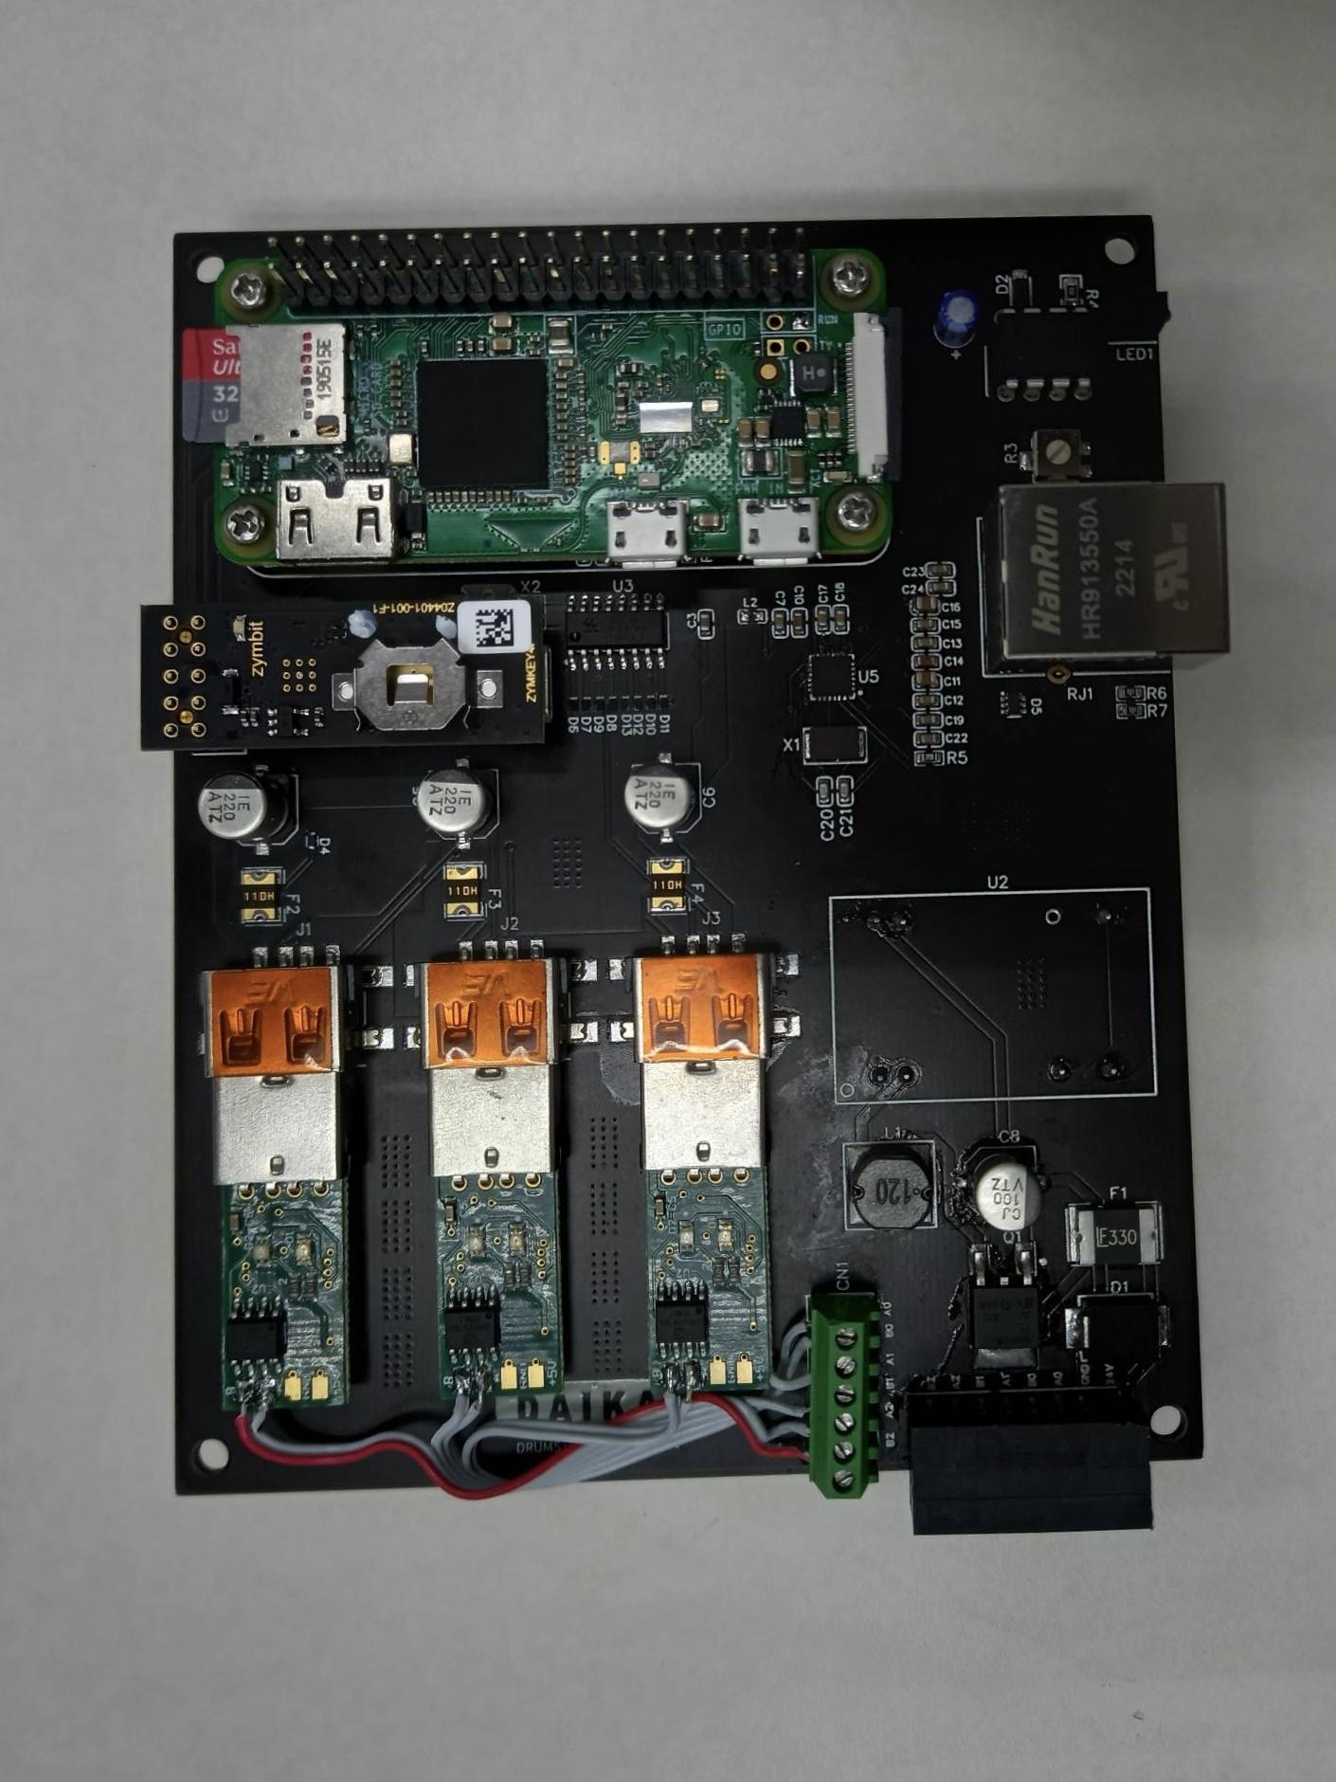




WHAT IS DRUMS?
Data Collection & Monitoring
Machine Learning & Dashboards
Actionable
Insights
Daikai Engineering Pte Ltd
Notes:
What is DRUMS?
It is a data collection and monitoring system created with the purpose of tracking the performance of marine engines.
The collected data is analysed via machine learning and dashboards to provide meaningful insights such as detection of engine problems or anomalies.
Additionally, DRUMS users are alerted of any issues, allowing for immediate action to prevent damage of the engine.

Slide 3




WHY DRUMS?
Centralised
Data
Remote
Monitoring
Smart
Analytics
Efficient Decisions
Daikai Engineering Pte Ltd
Notes:
Why should you use DRUMS?
Traditional vessel engine monitoring relies on
manual checks
slow reports
which are prone to human errors.
DRUMS fixes this by
collecting data continuously,
allowing remote monitoring and
near real-time visibility of engine health
so teams can predict issues, plan maintenance earlier, and reduce unexpected downtime.

Slide 4


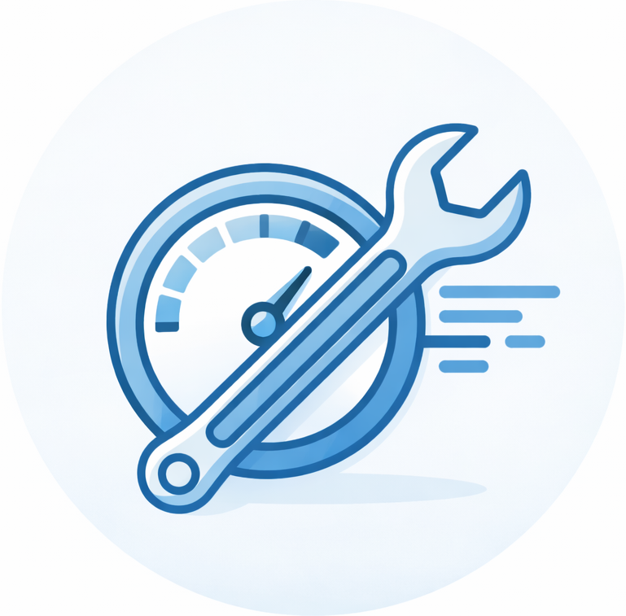

TECHNOLOGY ADVANTAGES & LIMITATIONS
Near Real-Time Monitoring
Centralised Data Platform
Operational Efficiency
Predictive Maintenance
Considerations
Requires stable connectivity and initial deployment cost
Daikai Engineering Pte Ltd

Slide 5





DATA SECURITY & SYSTEM PROTECTION
Secure Data Transmission
Authentication & Access Control
Multi-Layer
Security
Vessel-Level Data Protection
Audit &
Monitoring
Daikai Engineering Pte Ltd

Slide 6


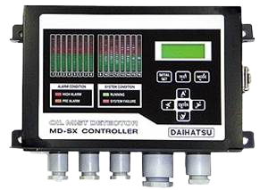
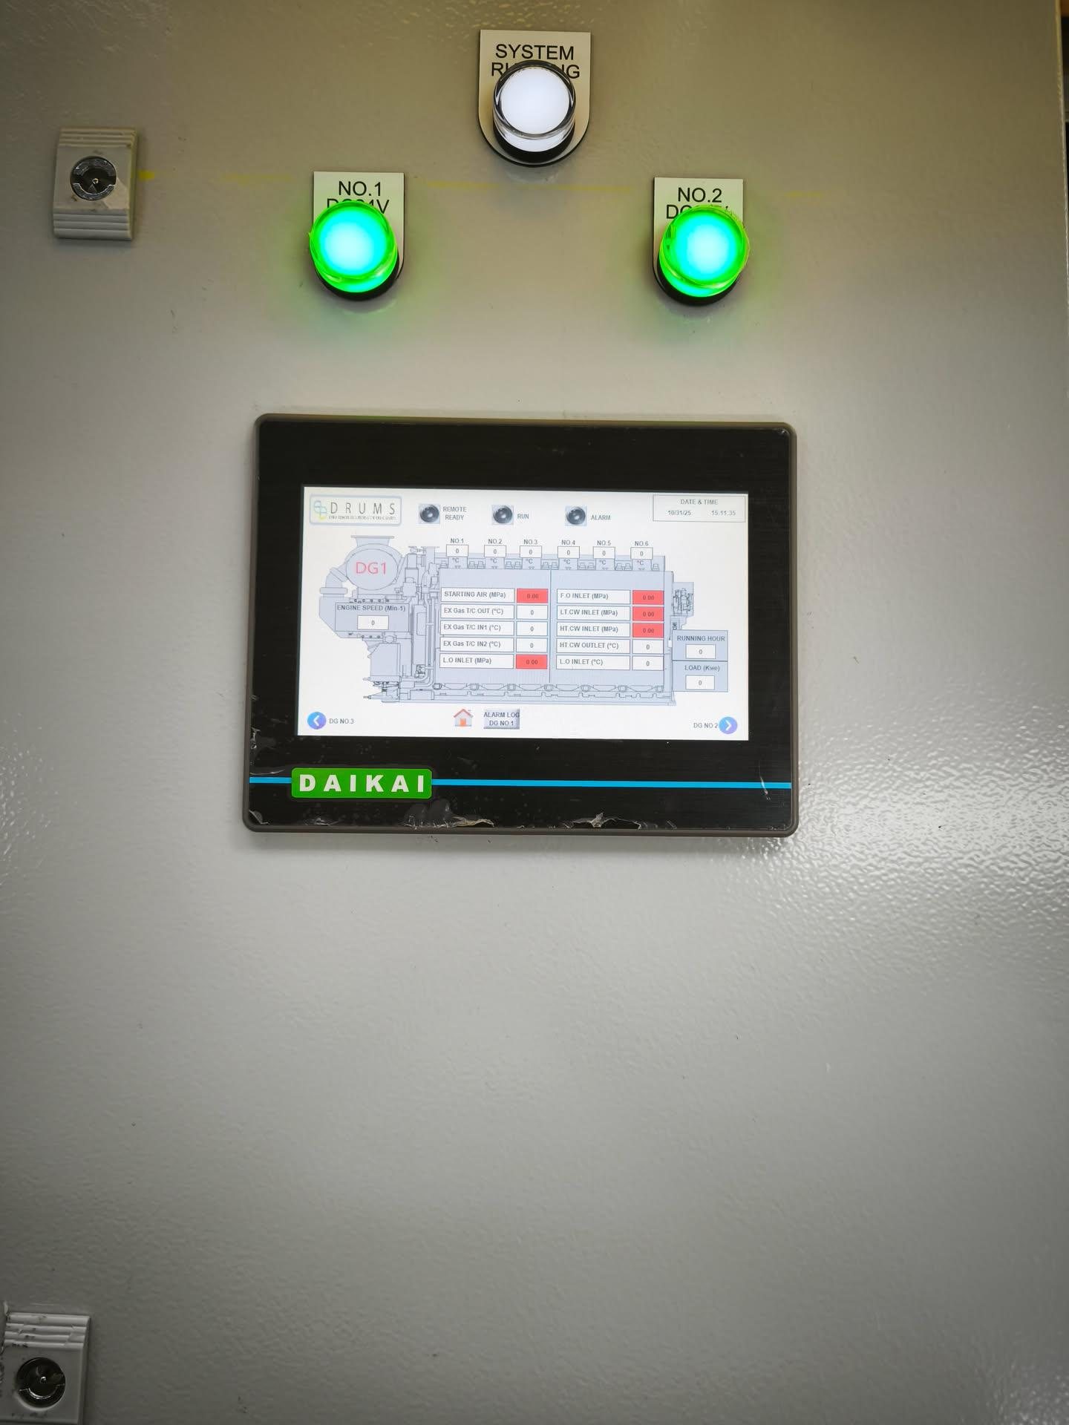

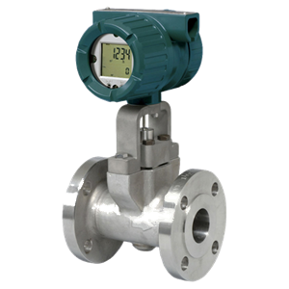
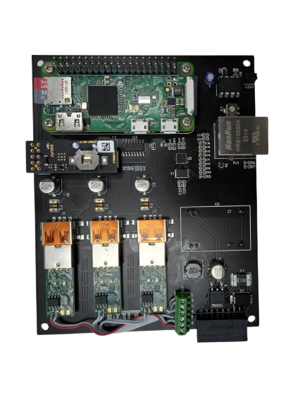
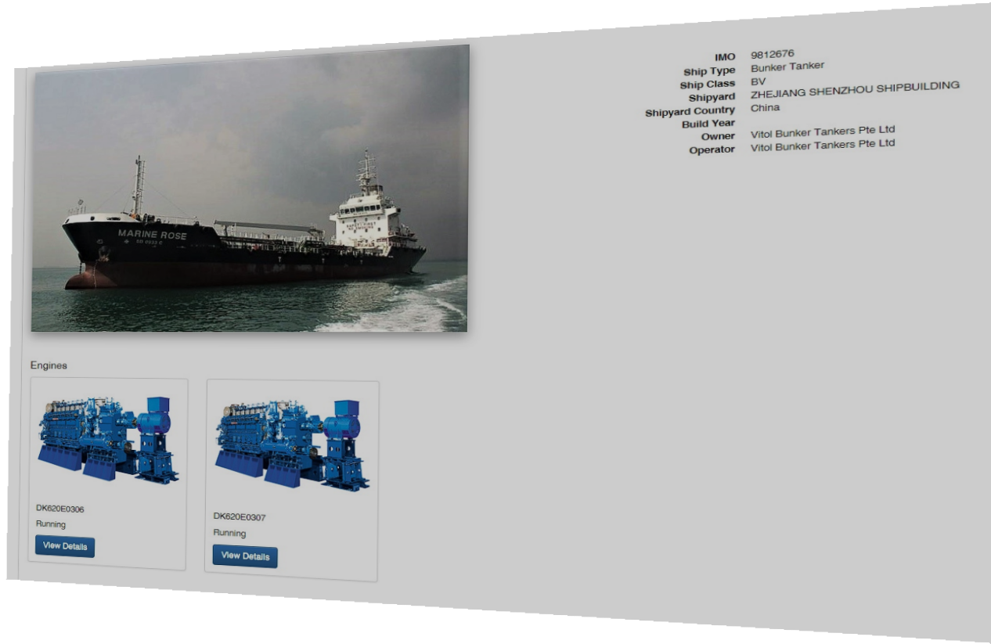
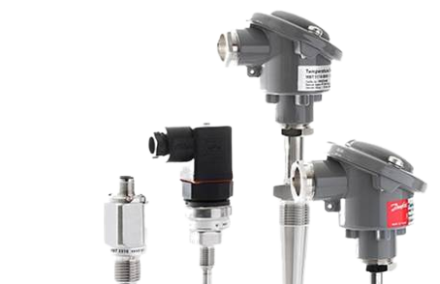
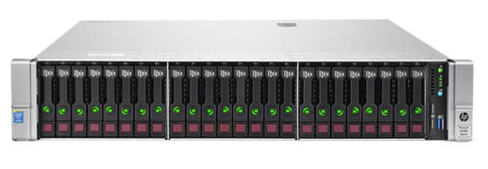
DRUMS CONFIGURATION
Collection of data from Daihatsu DECSS via Serial Interface
MODBUS, DECSS, individual wiring
Internet
Internet
Sensors
Data Collector
Remote Monitoring
Server
DRUMS website
Approx.
11.2 KB CSV file
Compressed & encrypted
Data of ~51.2 KB is instantly transmitted every 3 minutes.
Daikai Engineering Pte Ltd
Notes:
DRUMS System Overview:
DRUMS collects engine data on the vessel from several onboard systems and sensors.
This data is gathered into the DRUMS Data Collector, which prepares it safely and efficiently.
Then, every 3 minutes, it sends a small amount of data to the remote monitoring server.
Because the data size is small, DRUMS can still send updates reliably even when the ship’s internet is weak or unstable.

Slide 7


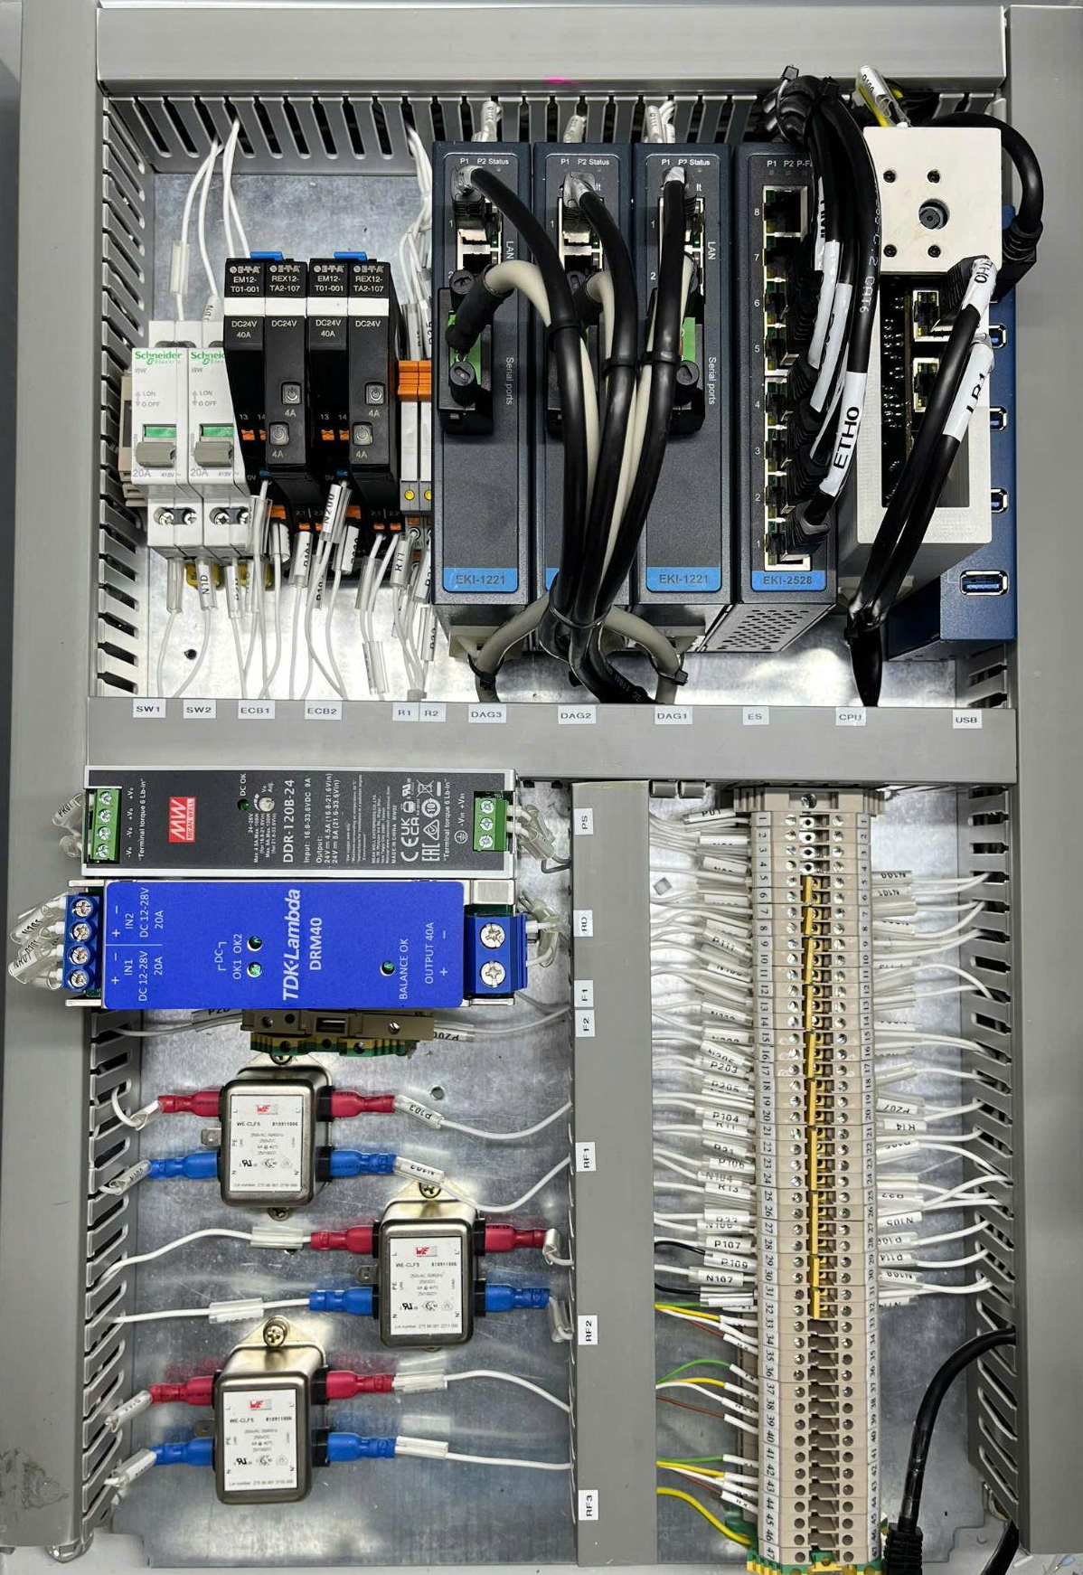
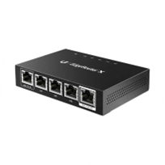

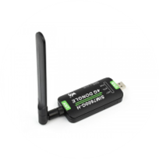

CONNECTIVITY OPTIONS
Wi-Fi router
Wi-Fi
The Vessel internet
Router
Cloud Server
RJ45/ethernet
Cellular network
Cellular dongle
Daikai Engineering Pte Ltd

Slide 8
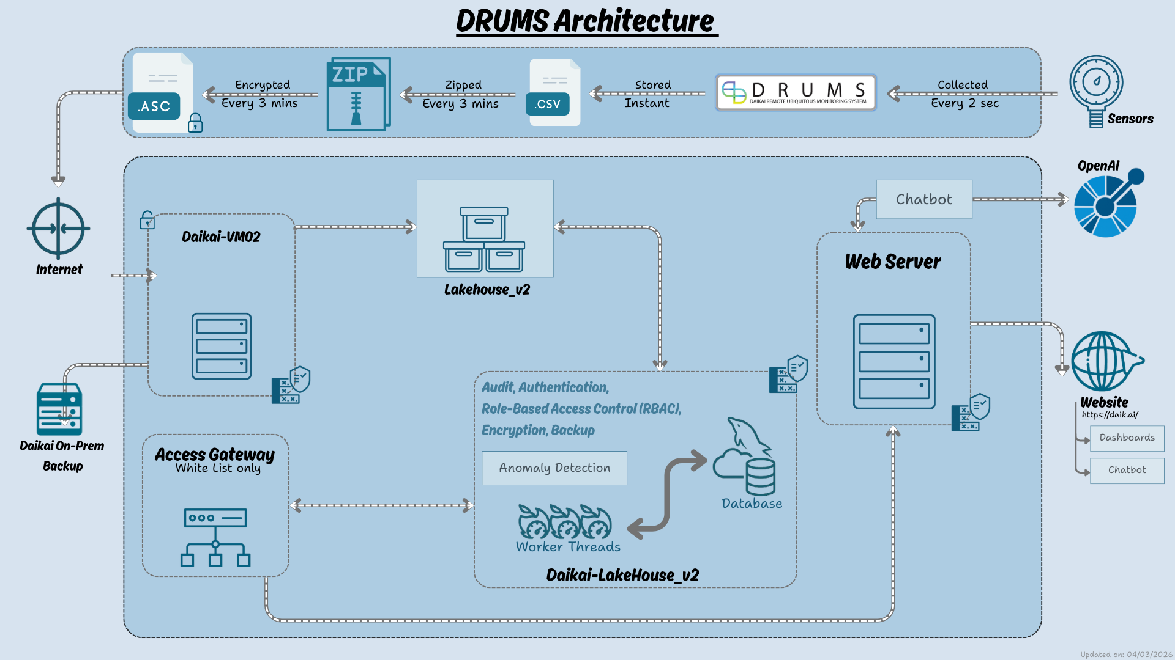
DRUMS ARCHITECTURE
Daikai Engineering Pte Ltd

Slide 9




SUPPLY RECORDS
Vitol (4 Vessels)
Emarat (6 Vessels)
Truongminh (4 Vessels)
Jemla (1 Vessel)
Daikai Engineering Pte Ltd
Notes:
DRUMS is already deployed across 15 vessels from:
Vitol from Singapore
Emarat from UAE
Truongminh from vietnam
Jemla from indonesia
These real-world deployments validate the system’s stability and reliability.

Slide 10
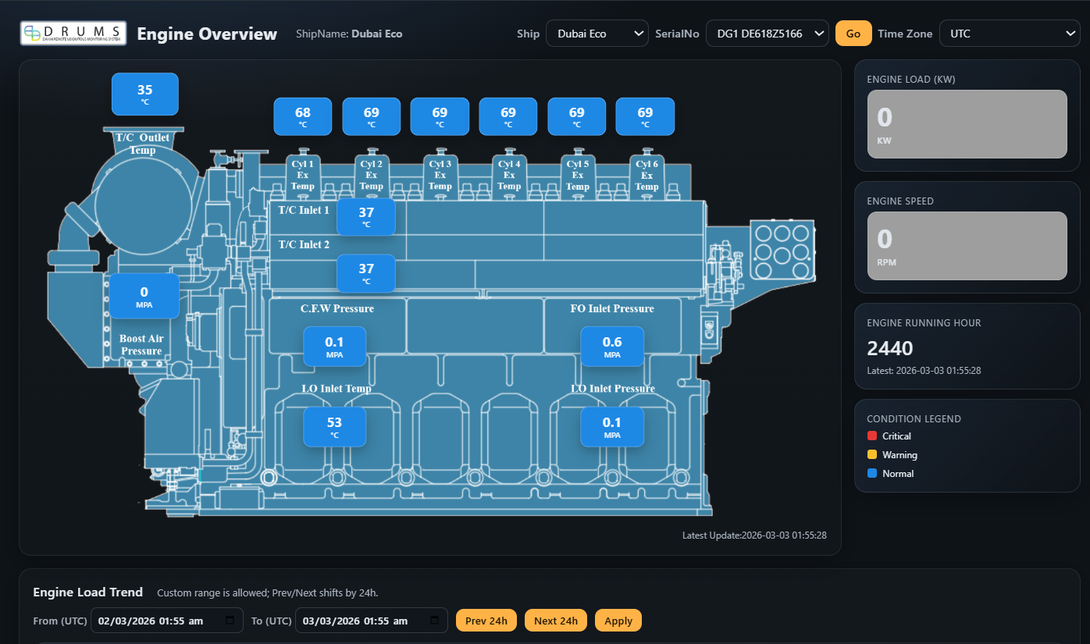
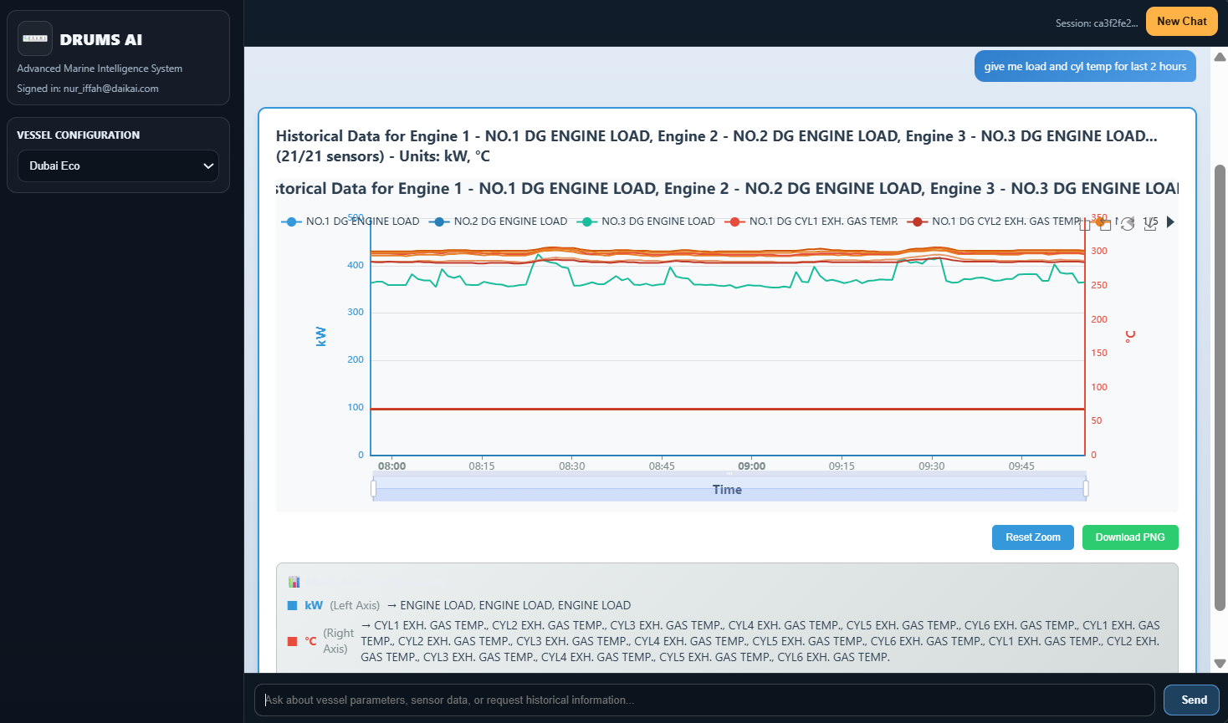
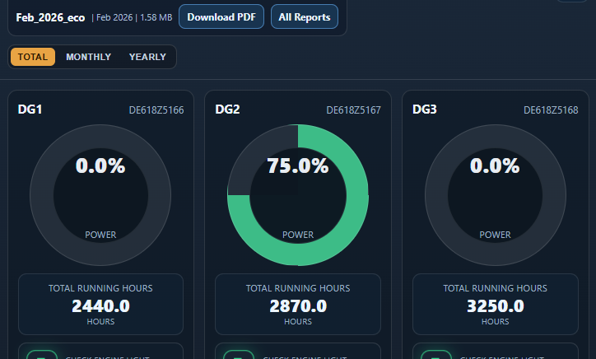
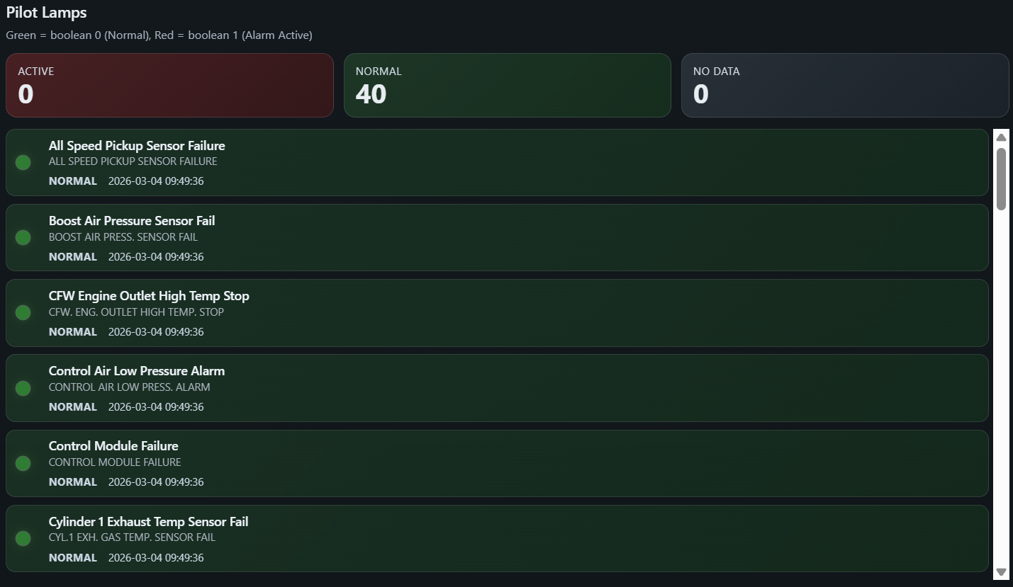
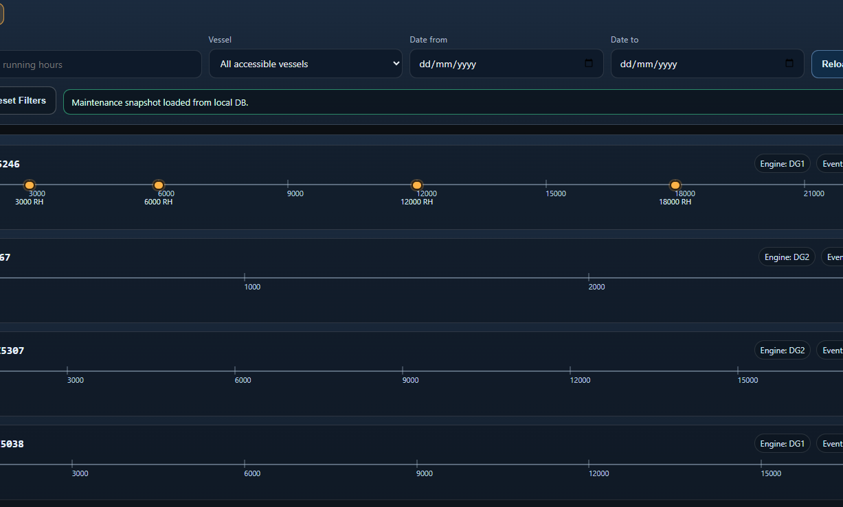
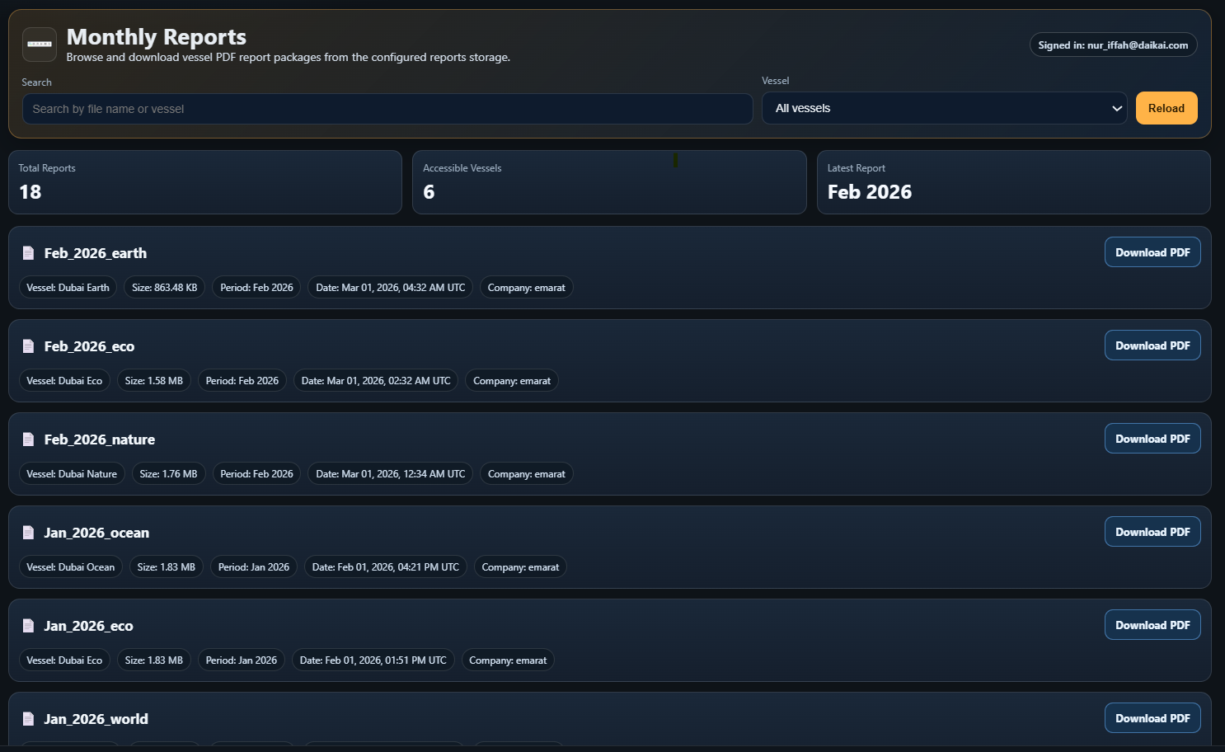
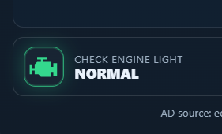
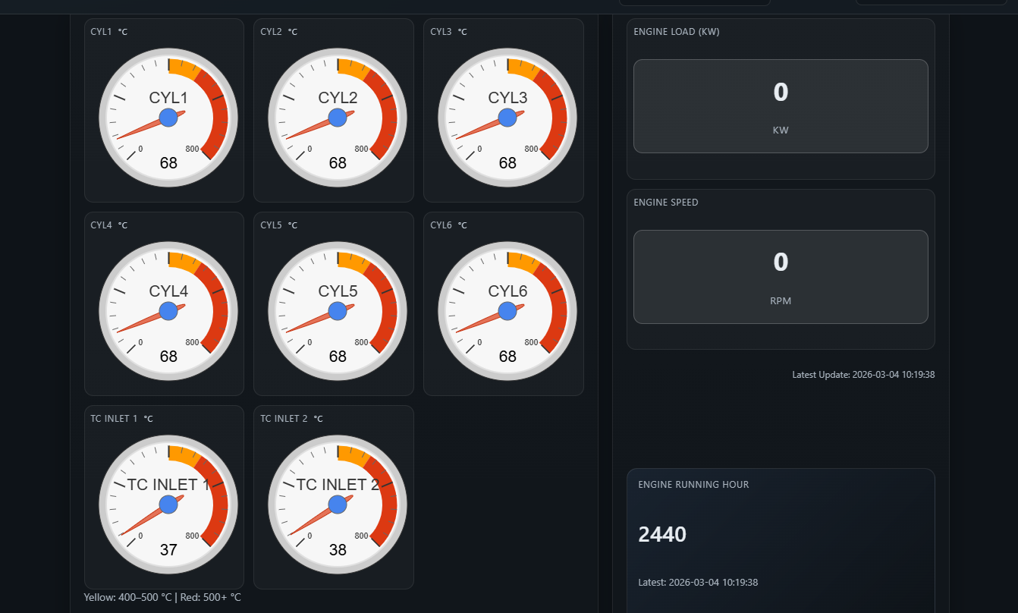
CORE FEATURES
Dashboards
AI Chatbot
Homepage Console
Alarms
Maintenance Record
Monthly Report
Anomaly Detection
Exhaust
Daikai Engineering Pte Ltd

